Slide 1


Analytical CRM Development for a Bank
PROJECT
Presented by: Jyoti Paliwal

Slide 2




Understanding Customer Relationship Management in Banking:
Problem Statement: The bank aims to reduce customer churn, improve service delivery, and enhance customer satisfaction through effective CRM strategies.
Objective of the Project:
Importance of (CRM) for Banks
Reduce Customer Churn: Identify factors contributing to customer attrition and implement strategies to mitigate churn rates.
Improve Service Delivery: Enhance the quality and efficiency of services offered to customers based on their preferences and behaviors.
Enhance Customer Satisfaction: Understand customer needs and preferences to deliver personalized experiences that foster long-term loyalty.
Retaining existing customers is more cost-effective than acquiring new ones.
Enhancing customer satisfaction leads to increased loyalty and lifetime value.
Understanding customer behavior enables targeted marketing and personalized services.

Slide 3




Datasets Overview
We have been provided with several datasets containing valuable information:
Customer Info: Includes demographic details and customer exit information.
Active Customer: Provides insights into currently active customers.
Bank Churn: Contains customer credit scores, tenure, and churn status.
Credit Card: Details about customer credit cards.
Geography: Geographic location data.
Exit Customer: Information about customers who have exited.
Gender: Gender-related data.
Date: Date-related information.

Slide 4

Data Preparation for Analysis
Data Cleaning:
Remove duplicate records and handle missing values to ensure data quality.
Standardize data formats and correct any inconsistencies.
Feature Engineering:
Create new features that provide valuable insights or improve model performance.
Examples include deriving customer tenure from BankDOJ and Date features.

Slide 5

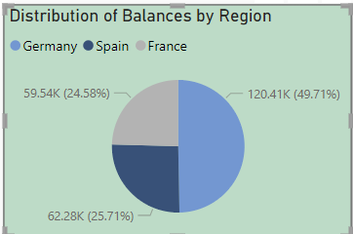
Demographic Analysis:
Germany: The percentage( 49.14%) of total account balances attributed to accounts in Germany.
France: The percentage ( 25.49%) of total account balances attributed to accounts in France.
Spain: The percentage (25.37%) of total account balances attributed to accounts in Spain.
Explanation: The pie chart indicates the proportion of account balances in each country, with Germany having the highest share, followed by France and Spain.
Insights: 119.73k the high numbers of accounts in Germany, France, and Spain correspond to the high account balances in the same order, reflecting the banking trends across these regions.

Slide 6
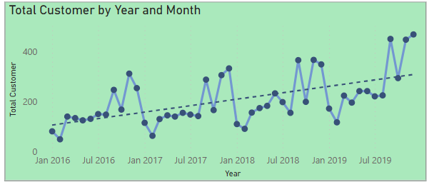

Transactional Analysis:
In our analysis of the trend of customers joining over time, we observed significant variations in the number of new customers joining the bank each month. By visualizing this trend with a line chart, we identified interesting patterns, including seasonal fluctuations.
One noteworthy observation is that in December 2019, there was a notable surge in new customer acquisitions, with a total of 470 new customers joining the bank according to the dataset provided. This spike in customer acquisition during December warrants further investigation to understand the underlying reasons and capitalize on potential opportunities.

Slide 7
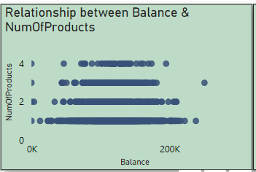
Transactional Analysis:
Utilized a scatter plot to analyze the relationship between the number of products and the account balance for customers who have exited the bank.
Observed a balance range of 0k to 300k among exited customers, indicating the spectrum of account balances contributing to churn.
Identified a trend where customers with fewer products, particularly those with only one product, exhibit a higher likelihood of churn.
Noted a contrasting pattern for customers with a higher number of products, particularly those with four products, suggesting lower churn rates.
Highlighted a balanced range between approximately 70k to 200k, where customers, regardless of their product portfolio, tend to exit the bank less frequently.
These findings offer valuable insights into the factors influencing customer attrition, enabling the development of targeted strategies to mitigate churn and enhance customer retention.

Slide 8
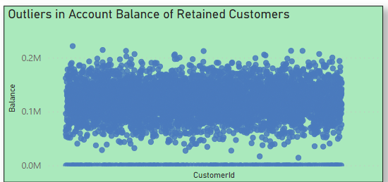
Identifying Potential Balance Outliers:
Utilized a scatter plot to identify potential outliers among customers who have remained with the bank.
Identified outliers based on balance observations, particularly focusing on customer IDs with balances of 0k and less than 50k.
Outliers signify customers with exceptionally low balances compared to the overall distribution, warranting further investigation into their behavior and potential impact on the bank's operations.
These outliers may indicate anomalies in account activity or financial circumstances, requiring tailored strategies for retention and risk management.

Slide 9
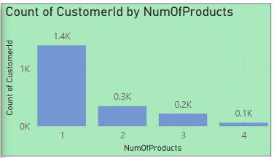
Customer Segmentation:
Analyzed the number of products used by customers who have exited using a bar chart.
Identified the most common number of products among exiting customers, which is 1, followed by 2, 3, and 4 products in descending order.
Highlighted that a significant portion of exiting customers had only one product with the bank, suggesting a potential correlation between fewer products and churn.
Provided insights into the distribution of product usage among existing customers, enabling the bank to strategize retention efforts effectively.

Slide 10

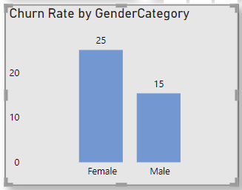
Churn Rate Analysis:
Data Filtering: Only data for the year 2019 was considered to analyze the most recent churn rate.
Calculation of Churn Rate: The Churn rate was calculated separately for male and female customers based on the number of customers who exited the bank divided by the total number of customers for each gender.
Interpretation
From the clustered column chart, it is evident that the churn rate for male customers in 2019 was 25%, while for female customers, it was 15%. This indicates that male customers had a higher churn rate compared to female customers during the specified period.

Slide 11

Year-wise Churn Rate Analysis
2016
In the year 2016, a count of 1951 customers have exited the bank. This represents the churn rate for that particular year.
In 2017, the churn rate increased slightly, with 2143 accounts being exited by customers.
2017
he year 2018 witnessed a further increase in churn rate, with 2593 accounts being churned.
2018
In the current year, 2019, we are experiencing the highest churn rate so far, with a count of 3313 accounts being exited by customers.
2019

Slide 12


Strategies to Control Churn Rate:
Targeted Retention Campaigns: Implement targeted retention campaigns based on customer segmentation to address specific needs and preferences, reducing churn.
Enhanced Customer Service: Enhance customer service and support to improve overall satisfaction and loyalty, thereby reducing churn.
Loyalty Programs: Introduce loyalty programs or incentives to incentivize customer loyalty and encourage retention.
Personalized Marketing: Personalize marketing efforts to address individual customer needs and preferences, fostering stronger customer relationships and reducing churn.
Product Optimization: Improve product offerings or features to meet evolving customer expectations, increasing satisfaction and reducing churn.

Slide 13
Gender Distribution
MALE
FEMALE
Male has 2867 active
accounts.
Female has 2284 active accounts.

Slide 14


Credit Card Holders
Credit card Holders
2434 Customers having credit cards.
Retain: There are 2180 customer retained in the bank
EXIT: There are 925 customers exits the bank.
ACTIVE: 1549 customers
ACTIVE: 409 customers
Not ACTIVE: 1349 customers
Not ACTIVE: 695 customers

Slide 15
CREDIT SCORE WORTHINESS
CREDIT SCORE RANGE | CREDIT WORTHINESS | CUSTOMERS COUNT
300-579 | POOR | 520
580-669 | FAIR | 685
670-739 | GOOD | 452
740-799 | VERY GOOD | 252
800-855 | EXCELLENT | 128

Slide 16

Conclusion:
Effective churn rate management is crucial for maintaining customer retention and enhancing overall satisfaction.
By identifying and understanding factors influencing churn rate, such as product usage and customer engagement metrics, banks can develop targeted strategies to mitigate churn.
Implementing retention campaigns, enhancing customer service, and introducing loyalty programs are effective strategies to control churn rate.
Predictive modeling using machine learning algorithms allows for proactive intervention and accurate churn prediction, enabling banks to retain valuable customers.
Incorporating customer feedback analysis into churn prediction models further enhances the accuracy of forecasts, facilitating informed decision-making.
Overall, proactive churn rate management strategies are essential for banks to foster long-term customer relationships and sustain business growth.

Slide 17
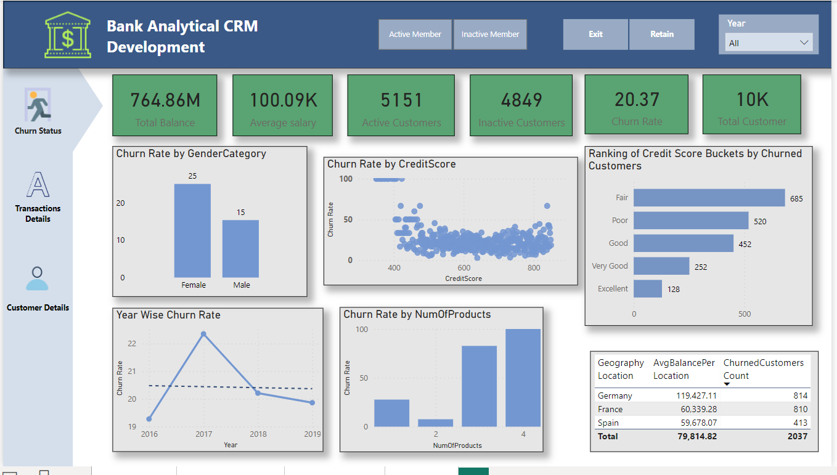
Dashboard Designing
Thank You!

Slide 18
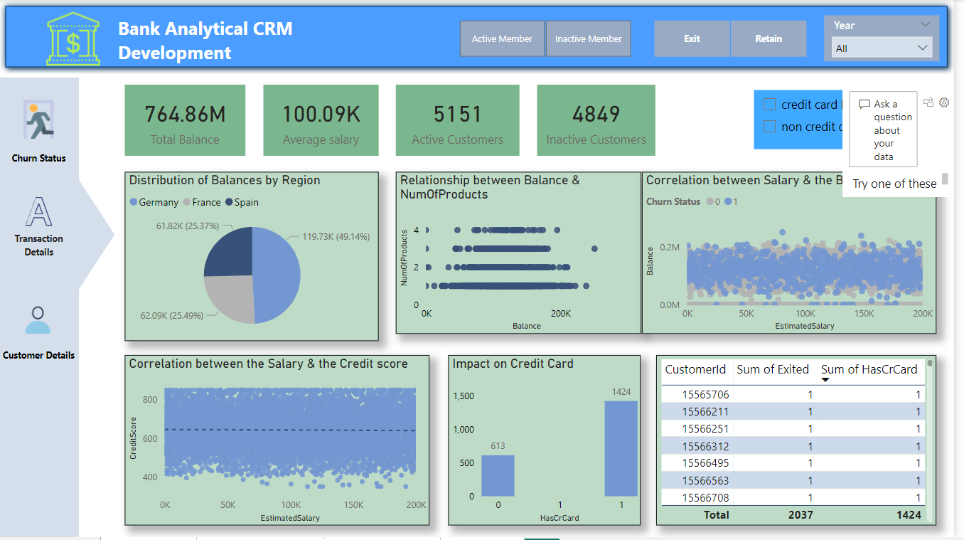
Dashboard Designing

Slide 19
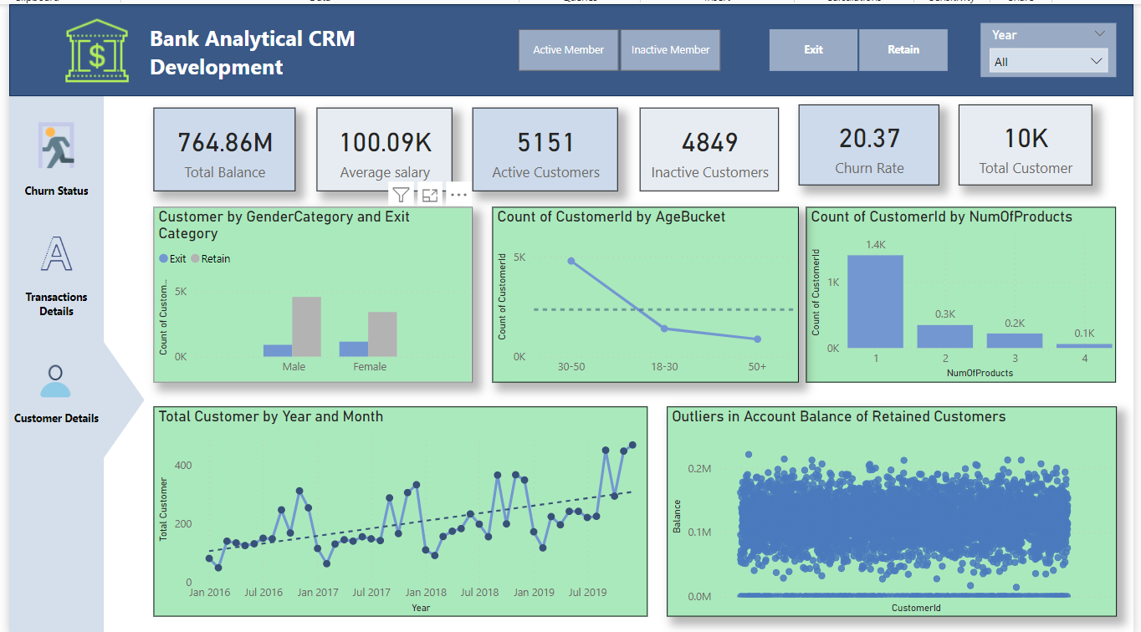
Dashboard Designing

Slide 20
Thank You!

